Slide 1
CSE 471: MACHINE LEARNING
Recurrent Neural Networks (RNN)

Slide 2
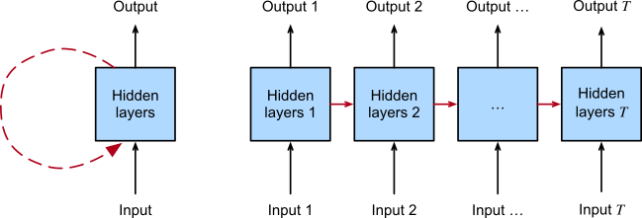
Recurrent Neural Network (RNN)
Left. Recurrent connections are depicted via cyclic edges. Right. We unfold the RNN over time steps. Here, recurrent edges span adjacent time steps, while conventional connections are computed synchronously.

Slide 3
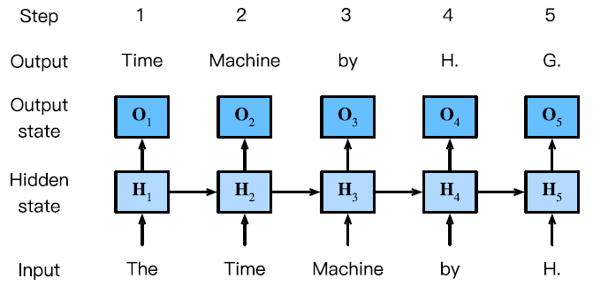
Recurrent Neural Network (RNN)

Slide 4


Recurrent Neural Network (RNN)
h_{t-1} : hidden state that stores the sequence information up to time step t-1

Slide 5
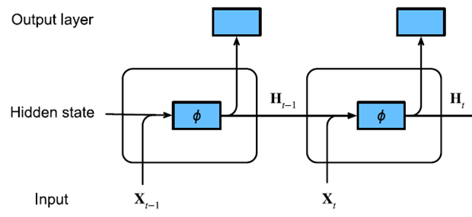
Recurrent Neural Network (RNN)
n – Number of sequence examples in a minibatch
X_{t} ∈ R^{n×d} – Each row corresponds to one example at time step t from the sequence.
H_{t} ∈ R^{n×h} – Each row corresponds to hidden layer output at time step t for one sequence example.
O_{t} ∈ R^{n×q} – Each row corresponds to output of the output layer at time step t for one sequence example.

Slide 6
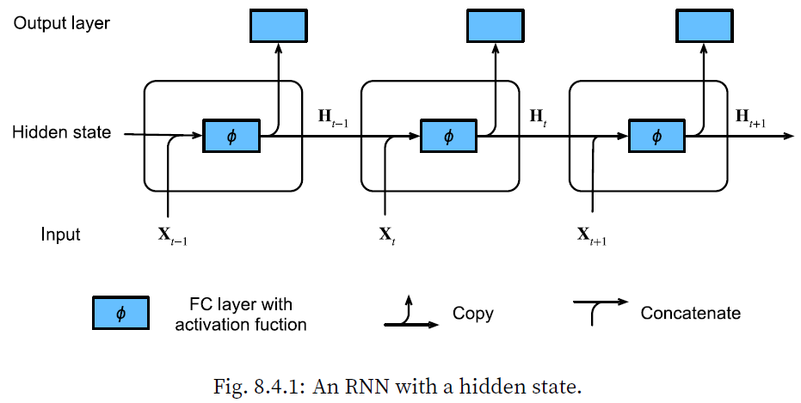
Recurrent Neural Network (RNN)

Slide 7


RNN
W_{xh} ∈ R^{d×h}
W_{hh} ∈ R^{h×h}
b_{h} ∈ R^{1×h}
W_{hq} ∈ R^{h×q}
b_{q} ∈ R^{1×q}
Same parameters are used across time.

Slide 8

Gradient clipping
Backpropagation through time – really deep chains
Gradients can explode or vanish
  Vanishing gradient problem is tackled by custom architectures.
  Exploding gradient problem is tacked by clipping
    Learning rate can be reduced
    But then learning will be too slow when gradient did not explode.

Slide 9

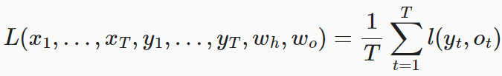
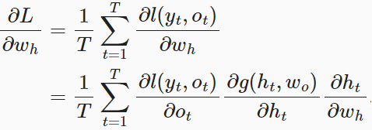
Backpropagation through Time

Slide 10

Backpropagation through Time
h_{t} depends on h_{t-1} and w_{h}
h_{t-1} also depends on w_{h}
The above equation is of the pattern a_{t} = b_{t} + c_{t}a_{t-1} with a₀ = 0

Slide 11

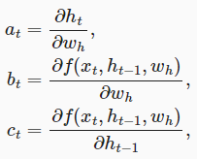

Backpropagation through Time
Very large chain through time

Slide 12
Backpropagation through Time
Full Computation
  Butterfly effect
  Almost never used in practice
Truncating time steps
  Truncate the sum in τ steps.
  Focuses primarily on short-term influence
  Biases the estimate towards simpler and more stable models.
Randomized truncation
Notes:
Butterfly effect. Minimal changes in the initial conditions lead to disproportionate changes in the outcome.

Slide 13

Randomized Truncation
Replace the derivative with a random variable
  Ensure correct expected value.
Let ξ_{t}
  P(ξ_{t}=0) = 1 – π_{t}
  P(ξ_{t}= π_{t}⁻¹) = π_{t}
Let z_{t}

Slide 14


Backpropagation through Time
Assumptions
  No bias parameter
  Activation = Identity function (Φ(x) = x)
At time stamp t
  An example input x_{t} ∈ R^{d}
  Corresponding label/target y_{t}
  Hidden state h_{t} ∈ R^{h}
  Output o_{t} ∈ R^{q}
W_{hx} ∈ R^{h×d}
W_{hh} ∈ R^{h×h}
W_{hq} ∈ R^{h×q}

Slide 15
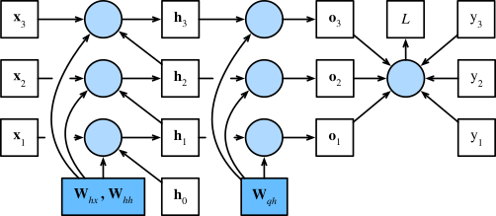
RNN Computational Graph
Computational graph showing dependencies for an RNN model with three time steps. Boxes represent variables (not shaded) or parameters (shaded) and circles represent operators.

Slide 16



Backpropagation through Time

Slide 17
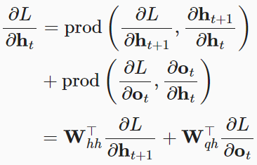

Backpropagation through Time

Slide 18
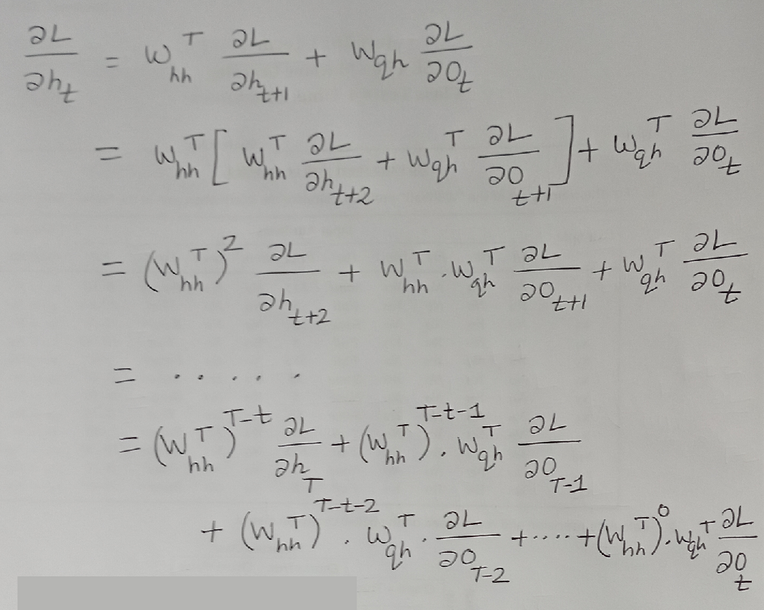

Slide 19
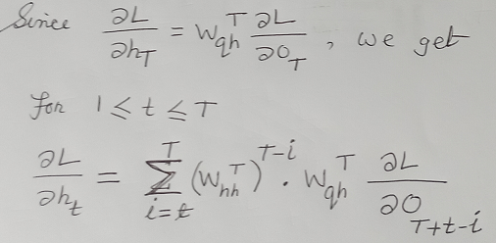

Slide 20
Backpropagation through Time
Very large powers of W_{hh}^{T}
  Numerically unstable
    Vanishing gradient
    Exploding gradient
Truncate the time steps

Slide 21
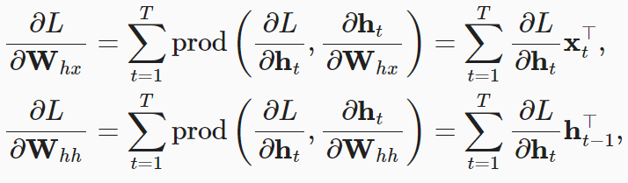
Backpropagation through Time

